Slide 1
Collections in Java

Slide 2
The Collection in Java is a framework that provides an architecture to store and manipulate the group of objects.
Java Collections can achieve all the operations that you perform on a data such as searching, sorting, insertion, manipulation, and deletion.
Java Collection framework provides many interfaces (Set, List, Queue, Deque) and classes (ArrayList, Vector, LinkedList, PriorityQueue, HashSet, LinkedHashSet, TreeSet).

Slide 3
What is Collection in Java
A Collection represents a single unit of objects, i.e., a group.

Slide 4
What is a framework in Java
It provides readymade architecture.
It represents a set of classes and interfaces.
It is optional.

Slide 5
What is Collection framework
The Collection framework represents a unified architecture for storing and manipulating a group of objects. It has:
Interfaces and its implementations, i.e., classes
Algorithm
The java.util package contains all the classes and interfaces for the Collection framework.

Slide 6
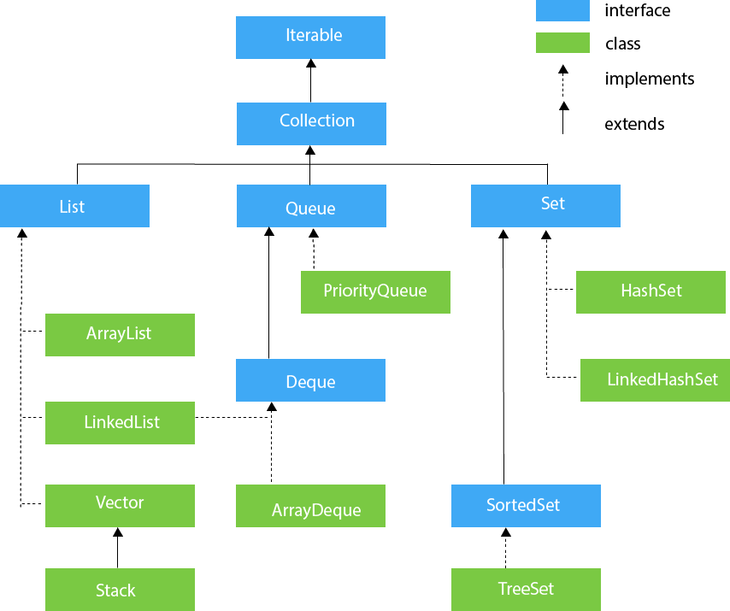
Hierarchy of Collection Framework

Slide 7
Iterator interface
Iterator interface provides the facility of iterating the elements in a forward direction only.
There are only three methods in the Iterator interface.
public boolean hasNext()
public Object next()
public void remove()

Slide 8
Iterable Interface
The Iterable interface is the root interface for all the collection classes.
The Collection interface extends the Iterable interface and therefore all the subclasses of Collection interface also implement the Iterable interface.
It contains only one abstract method. i.e.,
Iterator<T> iterator()

Slide 9
Collection Interface
The Collection interface is the interface which is implemented by all the classes in the collection framework.
Some of the methods of Collection interface are Boolean add ( Object obj), Boolean addAll ( Collection c), void clear(), etc. which are implemented by all the subclasses of Collection interface.

Slide 10
List Interface
List interface is the child interface of Collection interface.
It inhibits a list type data structure in which we can store the ordered collection of objects. It can have duplicate values.
List interface is implemented by the classes ArrayList, LinkedList, Vector, and Stack.

Slide 11
To instantiate the List interface, we must use :
List <data-type> list1= new ArrayList();
List <data-type> list2 = new LinkedList();
List <data-type> list3 = new Vector();
List <data-type> list4 = new Stack();
There are various methods in List interface that can be used to insert, delete, and access the elements from the list.

Slide 12
ArrayList
The ArrayList class implements the List interface.
It uses a dynamic array to store the duplicate element of different data types.
The ArrayList class maintains the insertion order and is non-synchronized.
The elements stored in the ArrayList class can be randomly accessed.

Slide 13
import java.util.*;
class TestJavaCollection1{
public static void main(String args[]){
ArrayList<String> list=new ArrayList<String>();//Creating arraylist
list.add("Ravi");//Adding object in arraylist
list.add("Vijay");
list.add("Ravi");
list.add("Ajay");
//Traversing list through Iterator
Iterator itr=list.iterator();
while(itr.hasNext()){
System.out.println(itr.next());
}
}
}

Slide 14
LinkedList
import java.util.*;
public class TestJavaCollection2{
public static void main(String args[]){
LinkedList<String> al=new LinkedList<String>();
al.add("Ravi");
al.add("Vijay");
al.add("Ravi");
al.add("Ajay");
Iterator<String> itr=al.iterator();
while(itr.hasNext()){
System.out.println(itr.next());
}
}
}

Slide 15
Vector
import java.util.*;
public class TestJavaCollection3{
public static void main(String args[]){
Vector<String> v=new Vector<String>();
v.add("Ayush");
v.add("Amit");
v.add("Ashish");
v.add("Garima");
Iterator<String> itr=v.iterator();
while(itr.hasNext()){
System.out.println(itr.next());
}
}
}

Slide 16
Stack subclass of Vector.
import java.util.*;
public class TestJavaCollection4{
public static void main(String args[]){
Stack<String> stack = new Stack<String>();
stack.push("Ayush");
stack.push("Garvit");
stack.push("Amit");
stack.push("Ashish");
stack.push("Garima");
stack.pop();
Iterator<String> itr=stack.iterator();
while(itr.hasNext()){
System.out.println(itr.next());
}
}
}

Slide 17
Java ArrayList
Java ArrayList class uses a dynamic array for storing the elements.
It is like an array, but there is no size limit.
We can add or remove elements anytime.
So, it is much more flexible than the traditional array.
It is found in the java.util package.
It implements the List interface so we can use all the methods of the List interface here.

Slide 18
ArrayList<int> al = ArrayList<int>(); // does not work
ArrayList<Integer> al = new ArrayList<Integer>(); // works fine

Slide 19
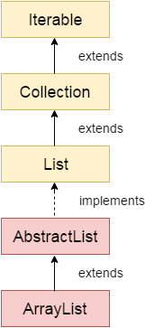

Slide 20
import java.util.*;
public class ArrayListExample1{
public static void main(String args[]){
ArrayList<String> list=new ArrayList<String>();//Creating arraylist
list.add("Mango");//Adding object in arraylist
list.add("Apple");
list.add("Banana");
list.add("Grapes");
//Printing the arraylist object
System.out.println(list);
}
}

Slide 21
Java Non-generic Vs. Generic Collection
Java collection framework was non-generic before JDK 1.5. Since 1.5, it is generic.
Java new generic collection allows you to have only one type of object in a collection. Now it is type-safe, so typecasting is not required at runtime.
The old non-generic example of creating a Java collection.
ArrayList list=new ArrayList();

Slide 22
The new generic example of creating java collection:
ArrayList<String> list=new ArrayList<String>();
In a generic collection, we specify the type in angular braces.

Slide 23
import java.util.*;
public class ArrayListExample1{
public static void main(String args[]){
ArrayList<String> list=new ArrayList<String>();//Creating arraylist
list.add("Mango");//Adding object in arraylist
list.add("Apple");
list.add("Banana");
list.add("Grapes");
//Printing the arraylist object
System.out.println(list);
}
}

Slide 24
Iterating ArrayList using Iterator
import java.util.*;
public class ArrayListExample2{
public static void main(String args[]){
ArrayList<String> list=new ArrayList<String>();//Creating arraylist
list.add("Mango");//Adding object in arraylist
list.add("Apple");
list.add("Banana");
list.add("Grapes");
//Traversing list through Iterator
Iterator itr=list.iterator();//getting the Iterator
while(itr.hasNext()){//check if iterator has the elements
System.out.println(itr.next());//printing the element and move to next
}
}
}

Slide 25
Iterating ArrayList using For-each loop
import java.util.*;
public class ArrayListExample3{
public static void main(String args[]){
ArrayList<String> list=new ArrayList<String>();//Creating arraylist
list.add("Mango");//Adding object in arraylist
list.add("Apple");
list.add("Banana");
list.add("Grapes");
//Traversing list through for-each loop
for(String fruit:list)
System.out.println(fruit);
}
}

Slide 26
Ways to iterate the elements of the collection in Java
There are various ways to traverse the collection elements:
By Iterator interface.
By for-each loop.
By ListIterator interface.
By for loop.
By forEach() method.
By forEachRemaining() method.

